Slide 1

PC builder web application
Team member:
Kevin Song
Siyuan He
Xu Zhang
Haimiao Yu
Chhanna Gaha
Sichao Liu
Guided By: Professor Henry Wong
Deliverable IV
Team Name: Dice

Slide 2

Introduction
A new application is made if a developer produces a new idea or when there is new technology to create better software. Our team viewed many existing online PC hardware stores, they are either created with older development tools or lacking functions that we need nowadays.
Therefore, we are here with a web application that is developed using React and other advanced technologies to achieve smooth browsing and satisfying functionality. This web app will guide students and users who have less experience on PC hardware to pick the right parts. Also, it will help experienced PC shoppers fulfill their dream of building their own pc.

Slide 3
Persona of a college Student
Hi, I am Nancy studying Bachelor's in Computer Science at North Georgia University. It’s difficult for me to pick a laptop out of many brands. There are ASUS, MSI, Dell and so many famous brands with similar hardware specs. I wish there is a good online application to help me identify which brand has the best hardware with the best price.

Slide 4
Persona of a software engineer
Hi, I am Jz Han. I am an experienced IT worker living in the Georgia suburb. In Georgia, the retail store is far away from where I live so I always shop for PC parts online. However, the websites that I am familiar with are only office related. They do sell PC hardware but it’s not their major business. I wish there was a web application that would just focus on selling PC parts. It would need to have a clear category breakdown and run smoothly just like any other shopping website.

Slide 5
Persona of a FilMmaker
Hi, my name is Mark. I’m an MFA of Filmmaking in the School of Visual Arts in New York. Next semester I will take classes related to video editing and color correction and I’m using 4K videos instead of 1080p videos. So I’m changing my main editing tool from Adobe Premiere to Davinci Resolve. I have a great Gaming Desktop and it worked well with Premiere, but after moving to Davinci it runs much slower. I was told that different professional software sometimes make more use of different components of the PC. When I was trying to find which part of my PC should be replaced, I found that all the current PC building websites separated their PC builds into categories like gaming PC, creator PC, or office PC. It would be helpful to have a PC Building website which can make buying suggestions based not only on the main use, but also based on the specific workflow and tools.

Slide 6
Persona of a Gamer
Hi, I am Jessi, a Bachelor at Pace University. I’m a big fan of AAA PC gaming so I plan to buy a powerful laptop which can be used for heavy gaming as well as course work. The existing PC websites only show the specs of the laptops. However, the gaming performance is not only related to the specs on the laptop. The thermal strategy, TDP settings, power management, and even pre-installed software will affect the gaming performance in the real world. These detailed information are not shown on existing websites. It would be great to have a website to show me the real gaming performance of each laptop to help me make purchase decisions.

Slide 7
MVP
Which problem does it solve?
For the customers who are not familiar with the computer specs and components, it is difficult to choose the right PC builds or laptops that meet their needs.
Minimum:
A website which allows customers choose and by PC components and laptops for meeting their different needs.
Viable:
A tool which can give useful and accurate information of the PC components and laptops. Also the tool can give customers advice for different use.
Minimum + Viable:
We are presenting a product which can provide real world performance information of PC and give suggestion to the customers for different use when they buy PC and laptops.

Slide 8
Product Backlog
# | Tasks | Role | User story | Priority
1 | Registration page/Account creation | User | As a user, I need an account to login to the website to buy items and keep my PC build list. | High
2 | Login page | User | As a user, I need to be able to login my account with my username and password. | High
3 | Logout ability | User | As a user, I want to be able to log out the site so my information will not access by other people who use the same machine. | High
4 | Database creation | Admin | As an administrator, I need to be able to store and manage products and users. | High
5 | Creating product page | Admin | As an administrator, I need to be able to list new products and see current stored product. | Moderate

Slide 9
Product Backlog
# | Tasks | Role | Features | Priority
6 | Shopping cart | User | As a user, I need the shopping cart to store all the items I want to buy. | High
7 | Profile and Shipping | User | As a user, I need a place to store my name and shipping, when necessary add them to order. | High
8 | Rating system | User | As a user, I need ability to rate the product so future buyer can avoid bad ones. | Low
9 | Place Order | User | As a user, I need ability to check out and get an ID of my Order. | High
10 | Receive Order | Admin | As an Admin, I need to be able to see all order placed by User | High

Slide 10
Acceptance Criteria
User Story | Accepted Criteria
As a user, I want to have an account to store my info and order placed, if no account I can register one in the page. | As a user visit the website, a home page with sign in button will be display. If user has a normal account, they are free to login, if not, the user can register a new account with a correct format email & password.
As a user, I want to browse all default build inside store and place order if needed. | As a user visit the website, all pre-built pc items will display. If user click add to cart, they will be redirect to a page to edit item number and place order. If user not check out immediately, item will be saved in cart.

Slide 11
Acceptance Criteria
User Story | Accepted Criteria
As a user, I want to save my profile info and use it to check out selected item. | When user picked item and saved to cart. They can add profile info include shipping. After user check out all items in cart, they will get an order ID. All order info will be passed to admin side so admin can deal accordingly.
As an admin, I want to login in a secure route so normal user don’t access my info. Also, I want to see user’s order info including paid status and shipping. | When admin visit website, they will use admin account to login as an admin user. The admin user can see current product inside database and all order user has placed.

Slide 12
# | scenario | Test Case | Test Data | Expected Result
1 | Register Normal user Admin user | Enter register info and click Register Error if the Email is not in correct format Mismatched password will be rejected Success registration will login user Normal user don’t access to admin route Admin user can see admin only menu | jim@yahoo.com Pw:123 admin@example.com Pw:12345 | The user should be able to type in Email and password and click. The user should see warning message about incorrect format. The user should see warning and be prevented from register. The user should login, have name displayed, redirect to home. Normal user only see logout option from drag down menu. Admin user have more option from drag down menu.
2 | Login Logout | Provide correct username & password Click on Login Button Click on Sign out Button from drag down menu | jim@yahoo.com Pw:1234 | The user should be able to type info and click sign in The user should securely login with name appear The user should securely logout and sign in button reappear
3 | Display item in Homepage | Input a new item in backend Go to the /api/products/seed Refresh page Checking homepage | An image and its description | The backend data should be successfully fetched. Product added in data should appear in database. Product info should now list in homepage.
4 | Cart | Click on an item Edit qty and click save the build Check cart icon Click on cart Display builds added to cart |  | The user should redirect to item detail page. The user should redirect to shipping cart with # items added. Cart icon should display total item type added. The user should redirect to cart page. All builds saved by user should list here with ability to edit item.
5 | Check out | Click on Proceed to Check out button Redirect to Sign in if user not sign in Provide correct shipping info Click on Continue |  | The user should redirect to shipping info page. The user should redirect to sign in page. The user should be able to enter shipping info If all info enter correctly, user will be redirect to order summary page.
6 | Order | Click on place Order Check Order summary page |  | The user will get an order detail page with the order ID Shipping ,name, address, Order ID, item info should be displayed
7 | Admin | Click on admin Click on Order placed |  | The admin will see drag down menu with order placed. The admin will see all orders placed by user.

Slide 13




Technologies we used

Slide 14

Project demo

Slide 15
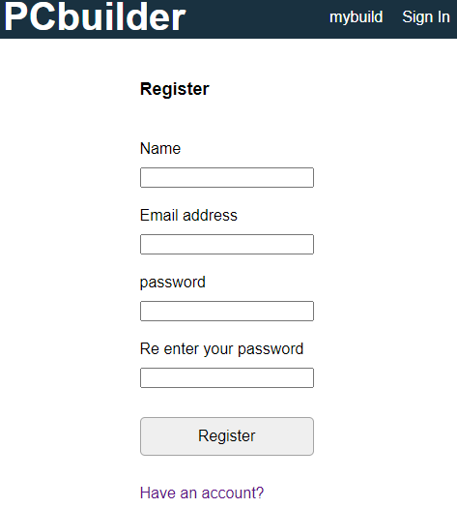
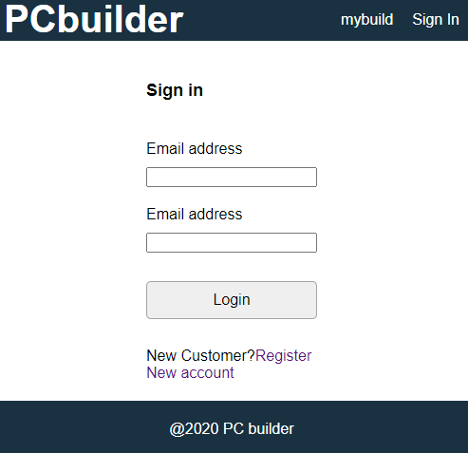

Slide 16
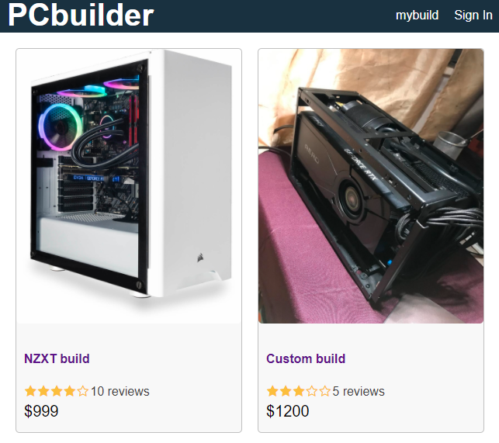
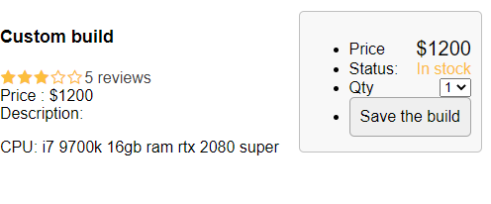
Main Page
login user will have their name appear on top right corner. After user click on desired product, they will be redirect to a page to save them.

Slide 17
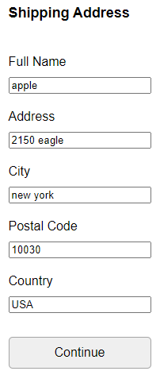
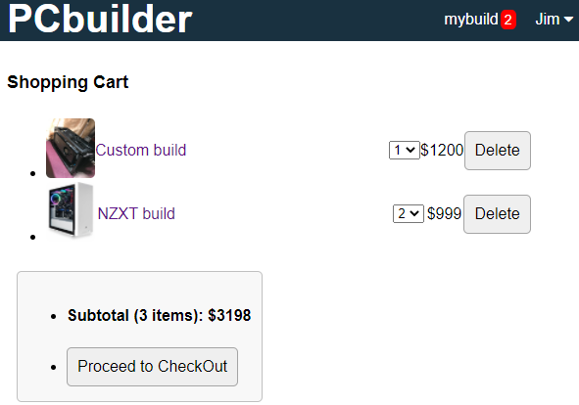

Slide 18
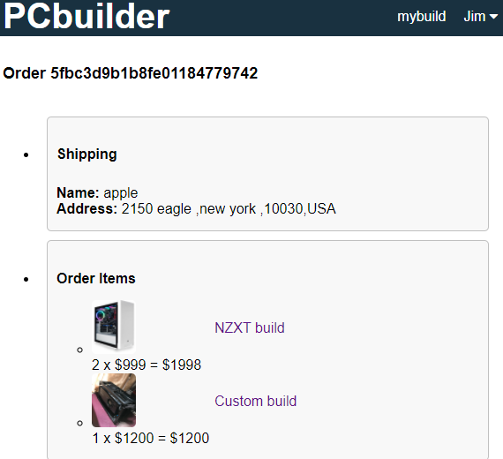
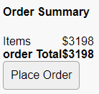
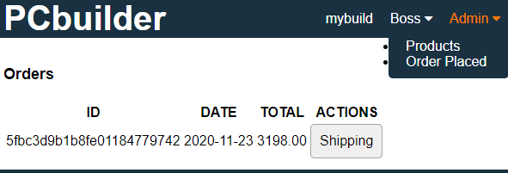
Once User done place order and log out, admin user can login and see order placed by normal user.

Slide 19
Sprint backlog
Team Dice Deliverable 1
What went well | Votes
Group come together and produce project ideal | 1
Clear division of work | 2
All members share their ideas of improvement | 1
What can be improved
Work on a presentation skills | 4
Rethinking about tools | 1
Contribution from every team member | 2
Sprint 1
Finalized project ideal | Gather information and technologies

Slide 20
Sprint backlog
Team Dice Deliverable II
What went well | Votes
Successfully created Login/Register page | 4
Successfully created mongo DB to store user’s data | 3
Alert function to detect wrong input | 3
What can be improved
Register not complete, user will have to be manually register | 2
Time Management | 4
Add a background image to the home page | 3
Sprint II
Made part of the project UI | Started on Implementation of Database

Slide 21
Sprint backlog
Team Dice Deliverable III
What went well | Votes
Successfully created backend with Node.js | 4
Successfully add redux to react app to manage state | 3
Created a place for user to save item and checkout | 3
What can be improved
Redux having issue reading from backend | 4
Time Management | 2
Some UI not displayed correctly, format. | 3
Sprint III
Add more frontend components | Implement API, adding actions and reduce

Slide 22
Sprint backlog
Team Dice Deliverable IV
What went well | Votes
Complete front end, back end. | 5
Add user register ability. | 3
Finalize database, add generate token function to generate ID | 3
What can be improved
Username should be display in order placed | 4
Some format not been commented, look messy and hard to fix | 4
Some data not passing correctly and be discarded | 2
Sprint IV
Finalize web app for acceptance criteria | Discuss the future development path

Slide 23
Scrum meetings
We do the scrum meeting every Tuesday
We discuss three things during scrum meeting.
What did we do last week?
What we are going to do this week?
Someone have an emergency?
Are there any issue during the development?

Slide 24
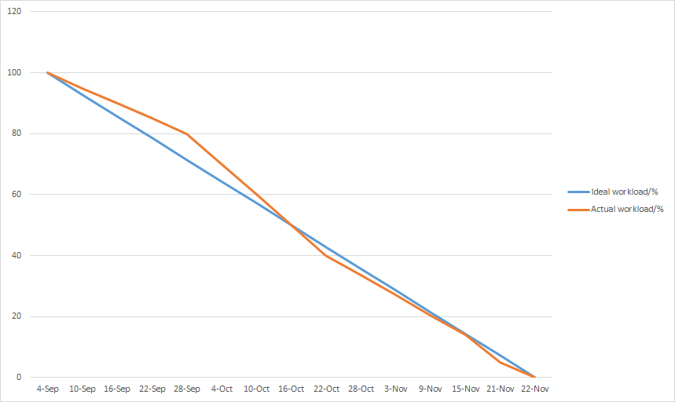
BURNDOWN CHART

Slide 25

Future scope
Give admin ability to edit user, product
A user profile page
User will have option to customize their pc.
A forum will be created as a community for our users.
Rating system.
Potential ability for user to chat with admin.
Optimization of the web page interface.

Slide 26

GitHub link
https://github.com/ksong227/CS691TeamDice
Thank You

